Slide 1
Stereotype Project
Aaliyah Richburg
Educ 2120
Dr. Kit Carson
November 2,2015

Slide 2
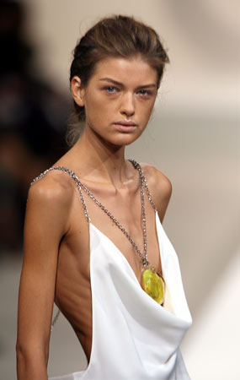
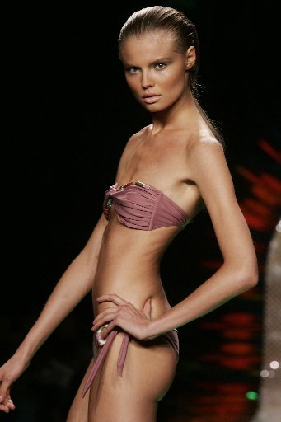
Only size 0 women can become models.

Slide 3
Only size 0 women can become models.
Years ago many agencies would only book those that were a size zero. Throughout the years being something other then a size zero have became popular. They also have plus size modeling. Victoria Secret was also a start for many women with different body types. They want women to embrace their curves showing women who are busty and also with curves.

Slide 4
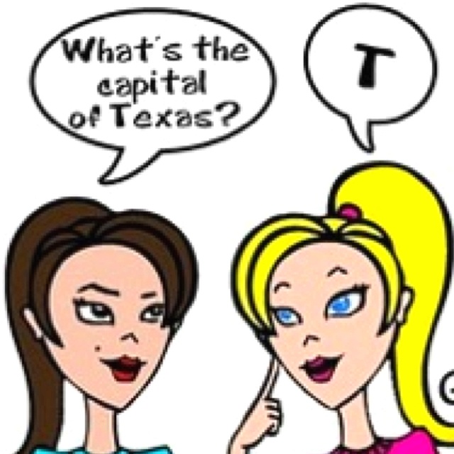

All blonde women are dumb.

Slide 5
All blonde women are dumb.
Scientists at Stanford University have disproved the “dumb blonde” stereotype with research that shows that hair color is not related to any other trait and does not affect intelligence. There are actually many smart blondes. Many who are doctors, scientists, and even teachers.

Slide 6
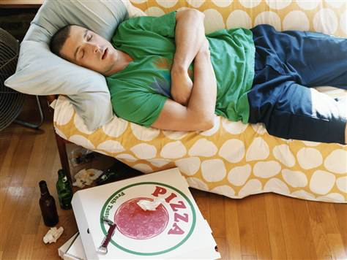
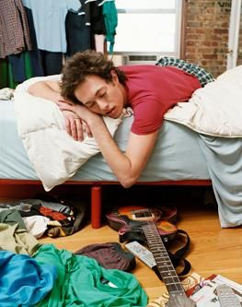
Guys are messy and unclean.

Slide 7
Guys are messy and unclean.
This is a untrue stereotype. Although some guys do have their habits often guys can also be the clean ones. To the contrary, millions of men consider themselves neat freaks, and they conduct chores such as sweeping, mopping, dusting dishwashing, clothes washing and so forth. A man’s neatness is determined by a wide variety of factors including his upbringing and personality. Children usually adopt the cleaning habits of their parents. Therefore, a man who has messy parents may develop messy traits, but a man who has neat parents may be extremely neat.

Slide 8

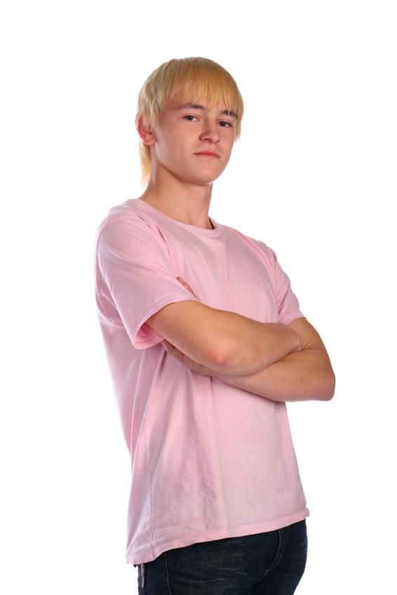
Men who like pink are effeminate.

Slide 9
Men who like pink are effeminate.
In 1927, Time magazine printed a chart showing sex-appropriate colors for girls and boys according to leading U.S. stores. In Boston, Filene’s told parents to dress boys in pink. So did Best & Co. in New York City, Halle’s in Cleveland and Marshall Field in Chicago. Pink is just a color. Years ago girls actually was the ones who wore blue and guys wore pink.

Slide 10
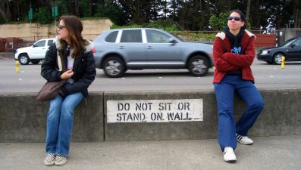
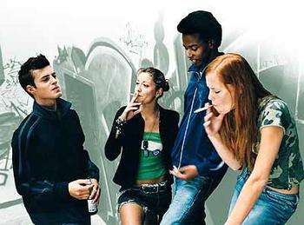
All teenagers are rebels.

Slide 11
All teenagers are rebels.
This stereotype isn’t true. Often there are teenagers who live there entire teen years without getting into trouble. Yes, there are teens who do rebel but NOT all.

Slide 12
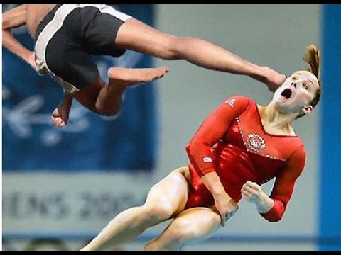
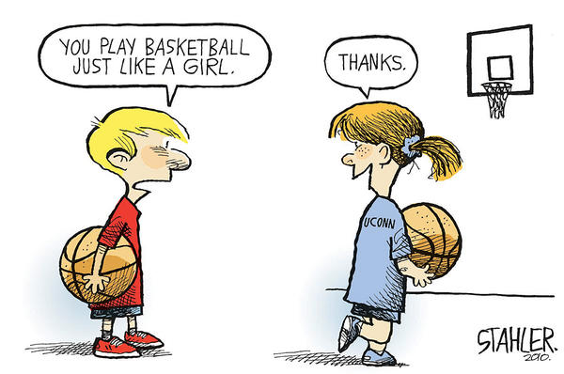
Girls are not good at sports.

Slide 13
Girls are not good at sports.
This is a very popular stereotype. Mostly from men. The reason behind this is because some men don’t feel traditionally women don’t play sports. They see men as the athletic ones. However, this stereotype is false. Women have achieved many rewards in sports. Example, Pamela Reed was the first woman to win the 135-mile Badwater Ultramarathon, coming in first in both 2002 and 2003. She was also the first person ever to run 300 miles without sleeping.

Slide 14
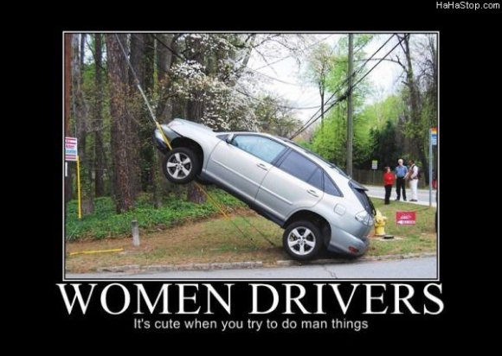
Women do not drive well.

Slide 15
Women do not drive well.
A commonly held stereotype is that women are poor drivers. This stereotype is recognized and endorsed by women and girls very early on, long before taking their driving license, nevertheless they are less involved in accidents and drive safer and less fast than men. Among the many findings of a city traffic study released on Monday was that 80 percent of all crashes in a five-year period in which pedestrians were seriously injured or killed involved men who were driving.

Slide 16
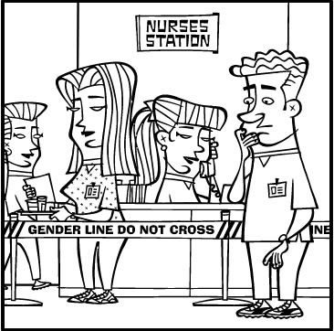
Only women can be nurses.

Slide 17
Only women can be nurses.
Nursing was once a predominately female profession, but it has become popular for men as well in recent years. The number of men in nursing is steadily increasing. Before modern day nursing, men were nurses, not women. The earliest recorded nursing school was established in India around 250 B.C. It was exclusively for men; women were not allowed to attend because it was believed that women were not as pure as men.

Slide 18
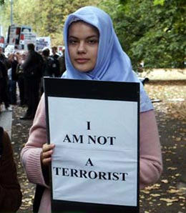
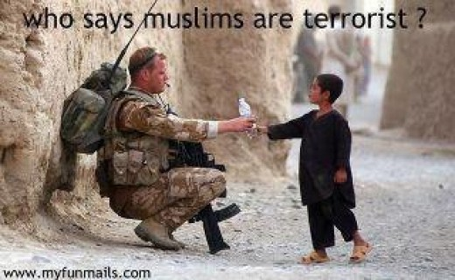
All Muslims are terrorists.

Slide 19
All Muslims are terrorists.
When many of us think about Muslims, we think about Arabs. When we think about Arabs, we think about Muslims. But many don’t realize that there are white and black Muslims. Some people look at someone's outside appearance who looks Arab and automatically call them Muslim and a terrorist when in fact they could be neither.

Slide 20
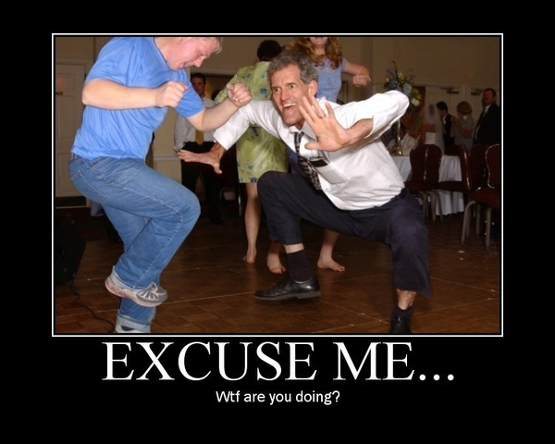
Whites have no rhythm.

Slide 21
Whites have no rhythm.
This is an untrue stereotype, although many whites have admitted to not having rhythm but other people of another race have also. There have been many competition of dance that whites have won involving both white males and females. On Feb. 20, 2010 a white team from university of Arkansas entered into a step competition with mostly African American competitors. They won the national step competition.

